Slide 1

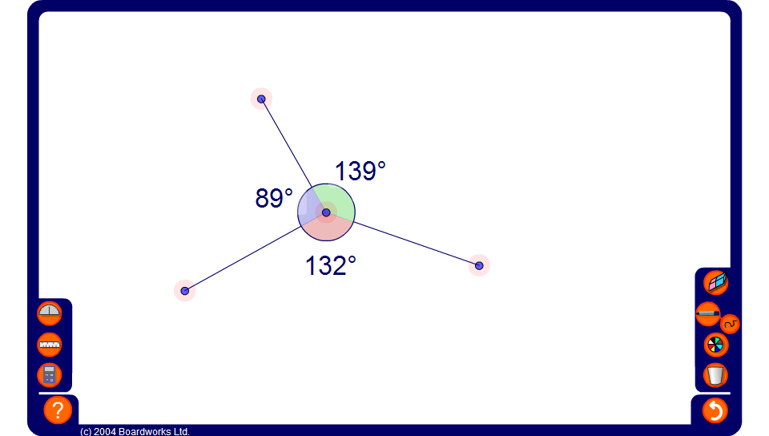


Angles around a point
Notes:
Move the points to change the values of the angles. Show that these will always add up to 360º.
Hide one of the angles, move the points and ask pupils to calculate the size of the missing angle.

